Slide 1
Moringa School Individual Project
Ivan Wawire

Slide 2
INTRODUCTION

Slide 3
Objectives
1. Understand Box Office Success Factors
2. Provide Actionable Insights
3. Inform Decision-Making:
4. Optimize Financial Returns

Slide 4
Steps
Data Loading
Data Inspection
Data Cleaning
Exploratory Data Analysis (EDA):
Summary and Reporting

Slide 5
Summary and Insights

Slide 6
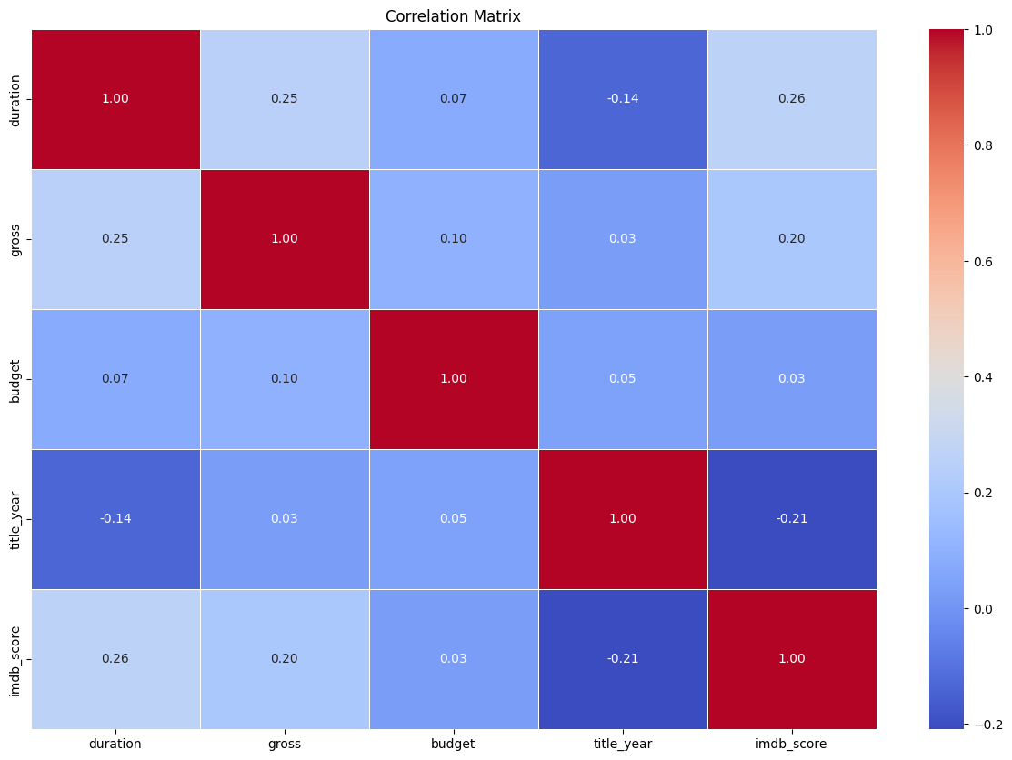
Correlation heatmap

Slide 7
Correlation interpretation
The correlation heatmap uses colors and number to show association between variables
It ranges from 1 to -1
1 indicates very strong correlation -1 weak correlation

Slide 8
Recommendations

Slide 9
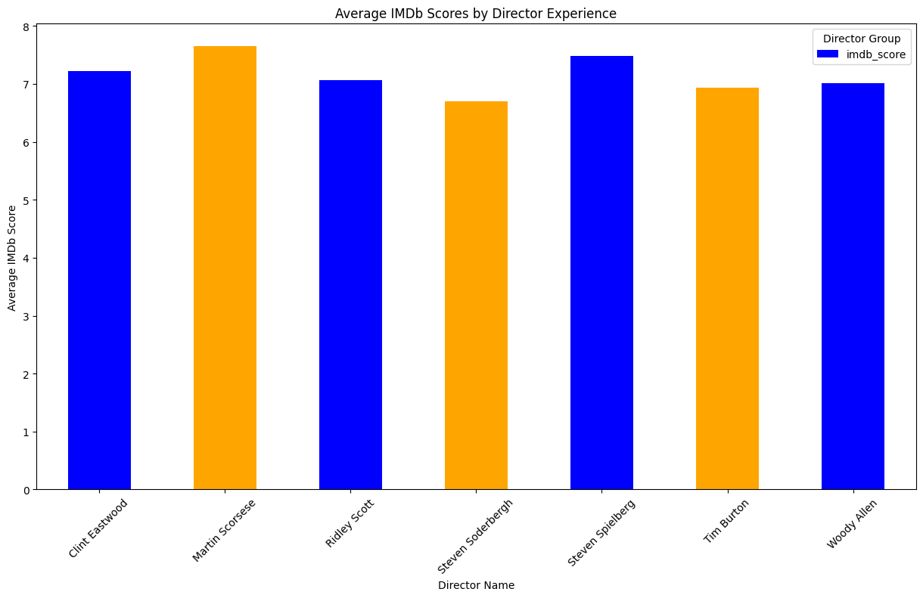
The correlation between directors and IMDb scores underscores the pivotal role of directors in shaping a movie's quality. This analysis emphasizes that the choice of a director significantly influences the overall excellence and reception of a film, reinforcing the importance of directorial expertise in achieving higher IMDb ratings.

Slide 10
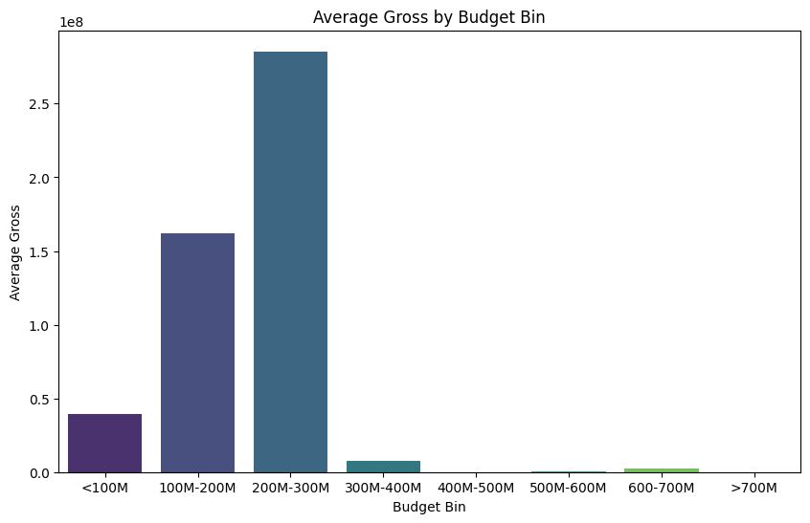
2..Based on the analysis of gross to budget, the optimal budget range for maximizing box office earnings is identified between 200𝑀𝑎𝑛𝑑 300M. Investing within this range is associated with the most favorable financial returns for movie productions.

Slide 11
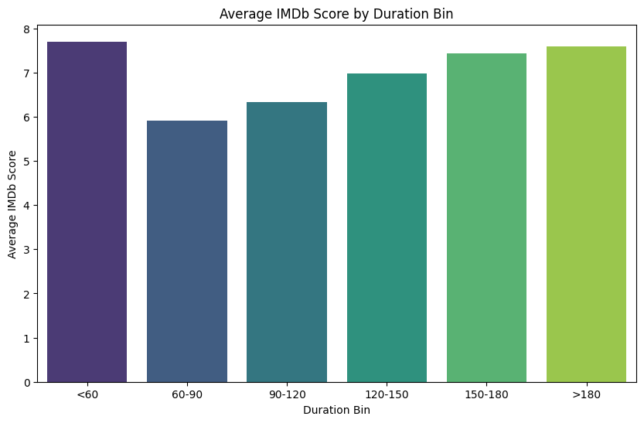
3.The examination of movie duration in relation to IMDb scores reveals that films with a duration less than 60 minutes achieve an average rating of 7.7. For movies lasting between 150 and 180 minutes, the average IMDb score is 7.5, while those exceeding 180 minutes attain a score of 7.6. This analysis suggests that shorter and longer durations are associated with slightly higher ratings compared to movies of intermediate length.

Slide 12
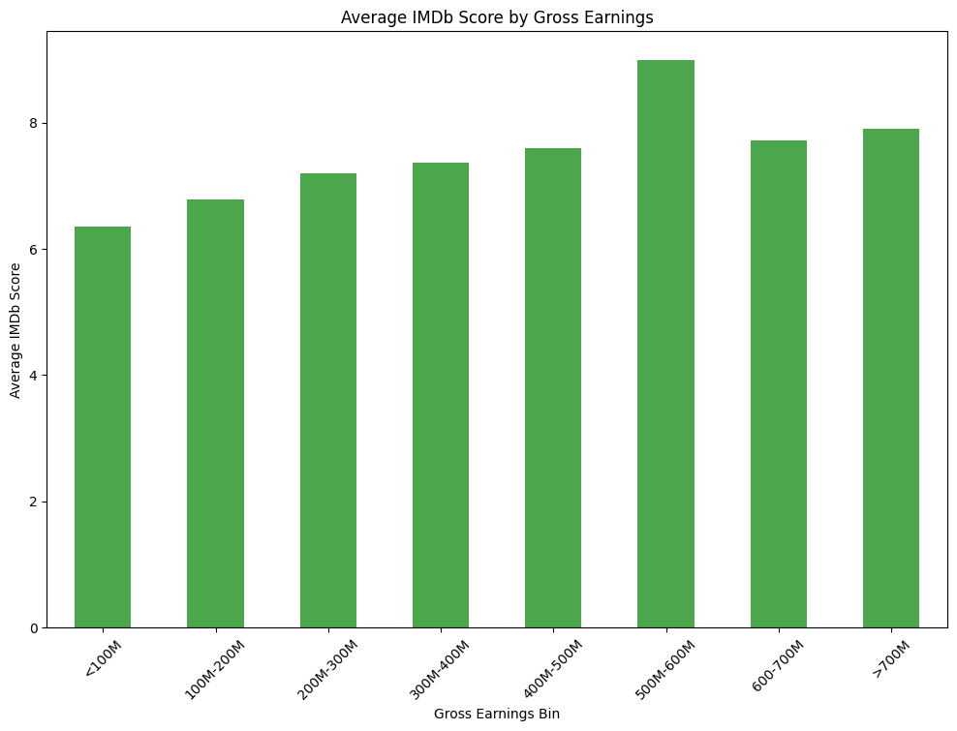
4.It is recommended to prioritize movies with higher IMDb scores, as they tend to yield increased gross earnings. However, caution is advised in the 500M- 600M gross range, as despite positive IMDb scores, a significant reduction in earnings is observed. Proactive decision-making is encouraged to optimize financial outcomes.

